Slide 1
Secure Data Hiding in Image using Steganography
CAPSTONE PROJECT
Presented By: Ayush Agrawal
Student Name : Ayush Agrawal
College Name & Department : Institute of Technology and Management Gwalior (AIML,CSE)

Slide 2
OUTLINE
Problem Statement
Technology used
Wow factor
End users
Result
Conclusion
Git-hub Link
Future scope

Slide 3
Problem Statement
Data security is a growing concern in the digital age.
Traditional encryption methods may be noticeable and blocked.
Steganography hides data within images, making it less detectable.
This project encrypts messages inside images to enhance confidentiality

Slide 4
Technology used
Programming Language: Python
Libraries Used: OpenCV, os, string
Concept: Image-based Steganography

Slide 5
Wow factors
Encrypts message inside images.
Uses color channels to store secret data.
Password protected decryption .
Minimal file size changes after encryption.

Slide 6
End users
Journalists & Whistleblowers – Secure communication.
Government & Defence Agencies – Confidential data exchange.
Cybersecurity Enthusiasts – Learning steganography techniques.
General Users – Hiding personal information securely.

Slide 7
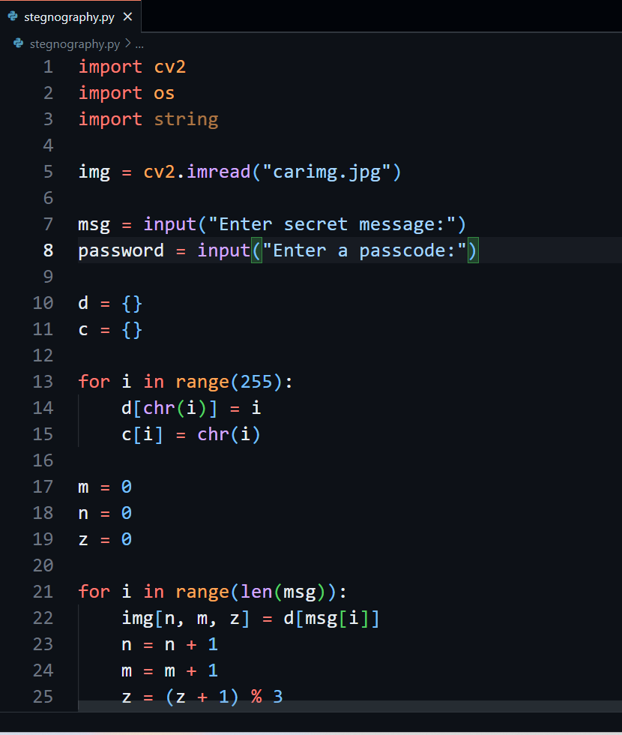
Results

Slide 8
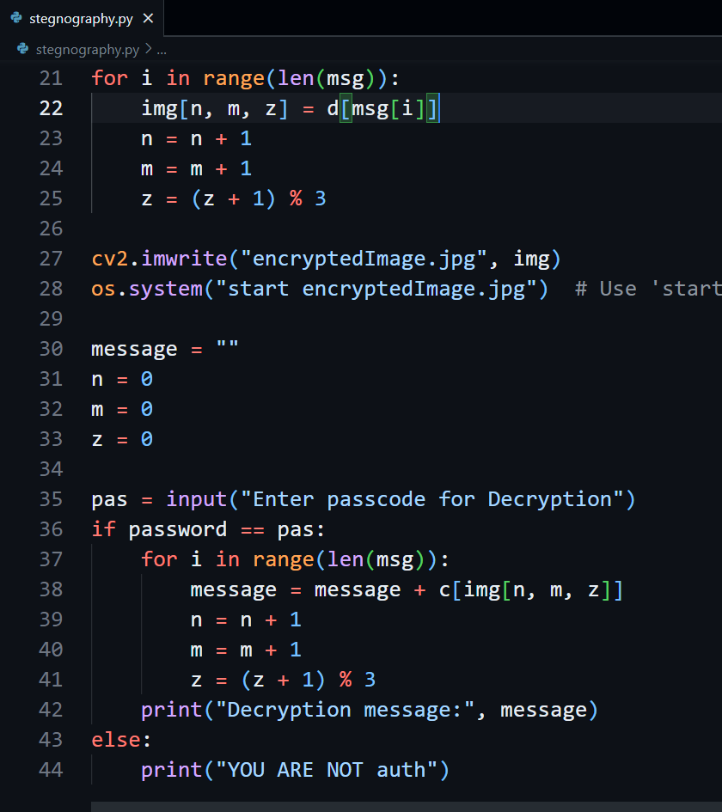
Results

Slide 9
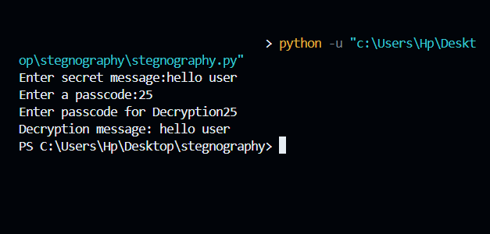
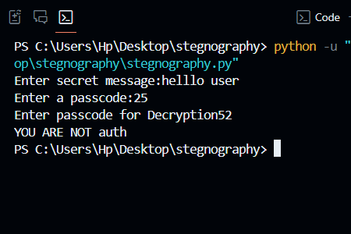
Results
With correct passcode
With incorrect passcode not allowed

Slide 10
Conclusion
This project demonstrates a simple yet effective method of secure data hiding .
Using steganography ensures the message remains undetected .
Helps in enhancing data security without drawing suspicion.

Slide 11
GitHub Link
https://github.com/AyushAgrawal-code/cyberprojectIBM.git

Slide 12
Future scope(optional)
Improve encoding efficiency using advanced steganographic techniques .
Implement AES encryption before hiding data .
Create a GUI-based user-friendly application for non-technical users.

Slide 13
THANK YOU

